Slide 1
SPEF (Standard Parasitic Extraction Format) Extractor
Done by:
Dina Usama
Youssef Amir
Salma Taalat

Slide 2
SPEF
Standard Parasitic Exchange Format (SPEF) is an IEEE standard for representing parasitic data of wires in a chip in ASCII format.
Non-ideal wires have parasitic resistance and capacitance that are captured by SPEF.
These wires also have inductance that is not included in SPEF.
SPEF is extracted after routing in Place and route stage. This helps in accurate calculation of IR-drop analysis and other analysis after routing. This file contains the R and C parameters depending on the placement of our tile/block and the routing among the placed cells.

Slide 3
Objectives:
To extract parasitic data ( resistance and capacitance ) of the interconnects.
Extraction is from the following input files:
A- DEF file
B- LIB file
C- LEF file

Slide 4
LEF
The lef file provided us with info related to the individual macros of all the possible cells that can be used.
The relevant info included all the pins associated with each macro and their directions.
It provides us with the resistance and capacitance per sheet for the different metal layers

Slide 5
DEF
The def file provided us with the details of the circuit itself.
This includes all the components in the circuit,
A- Nicknames,
b- Macro names,
c- Positions on the grid.
Netlist:
These are a set of all the nets in the circuit along with their associated components ( each component with the corresponding pin) that form the net with the other components and the routing of all the wires connecting these pins in the net.

Slide 6
SPEF Parts
1)Name Mapping
Lists the names of all the components in the net and gives them numbers as an abbreviation
2) Port listing
Lists the ports (associated pins to the components) along with their direction
3)Connections
<pin type ( port /internal) > <name (component and pinname )> <direction ( input, output, bidirectional) >

Slide 7
4) Capacitance section
<cap number> <node> <value>
Cap number: identifying number
Nodes: could be internal or actual ports of components ( number of internal nodes will be determined from the parsing of the routing section of the DEF file)
Value: determined by the CPERSQR * L * W + Edge Capacitance *L (length of wire calculated from the routing section ) This value is from node to ground

Slide 8
5) Resistance section
<resistance number> <node 1> <node 2> <value>
Resistance number: identifying number
Node1 and node 2: could be internal or actual ports of components ( number of internal nodes will be determined from the parsing of the routing section of the DEF file) . These nodes sandwich the resistance
Value: determined by the RPERSQR * (L /W) (length of wire calculated from the routing section )

Slide 9
1st Deliverable
DEF parser using c++
LEF parser using c++
LIB parser using c++
All required data needed for SPEF file is extracted and stored in data structures that should be easily output to the SPEF file.

Slide 10
2nd Deliverable
We worked on outputting the SPEF files using the parsers we built on the first milestone
1.Create function for calculating the length of the wire and the node it connects using the components and routing parsed from the DEF.
2.Create a function that calculates the new coordinates of the rects taking into consideration the different orientations on the grid to check for intersections between wires and pins of components
3. From the length of the wire, the capacitance and resistance will be calculated based on the aforementioned equations using the capacitance data and resistance data from the LEF file.

Slide 11
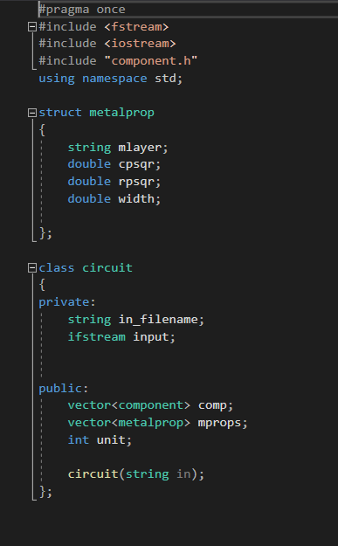
Main Classes
pin.h
component.h
Circuit.h
This class is responsible for parsing the LEF file and it stores all the metal properties and all the info related to each component along with their pins. It stores info related to components in vector <component> ct.

Slide 12
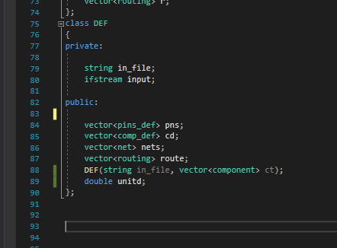
4) Def.h
This is the main class that parses the DEF file to store all their components along with their positions, ports, and nets. It uses vector<component> ct to allow the compilation of all the info needed in one data structure.

Slide 13
5) main22.cpp
This where the def and circuit are called then the unified data structure (d) is used to output the spef file.

Slide 14
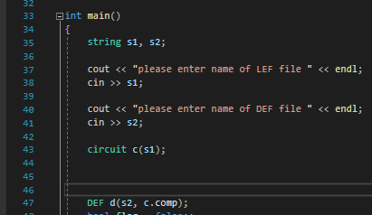
Data Structures
To create the main data structure used to output the SPEF the two classes are called in the following way.

Slide 15
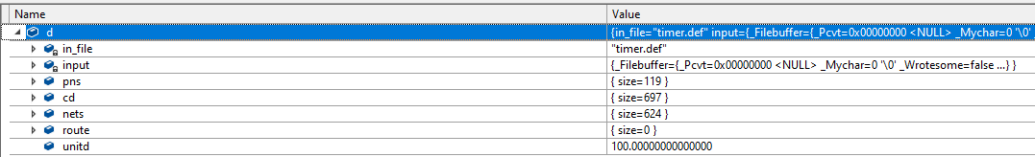
Now, we will explore the data structure “d”.....

Slide 16
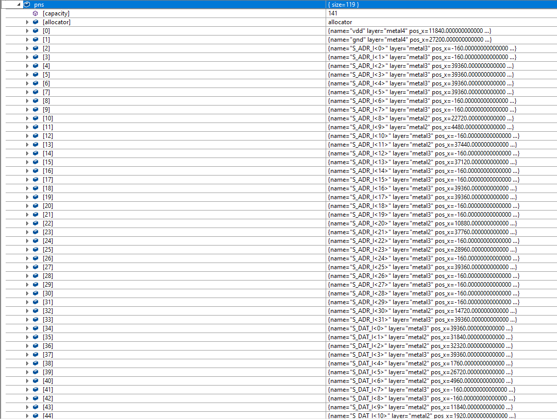
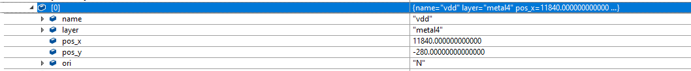
Unitd : This is unit used for conversion in the def file
Pns: These contain the main ports in the def file along with detailed info about them as shown below

Slide 17
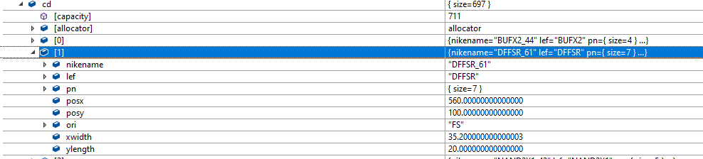
3. Cd: contain all the components with their positions on the grid, orientation, and dimensions (from the lef)

Slide 18
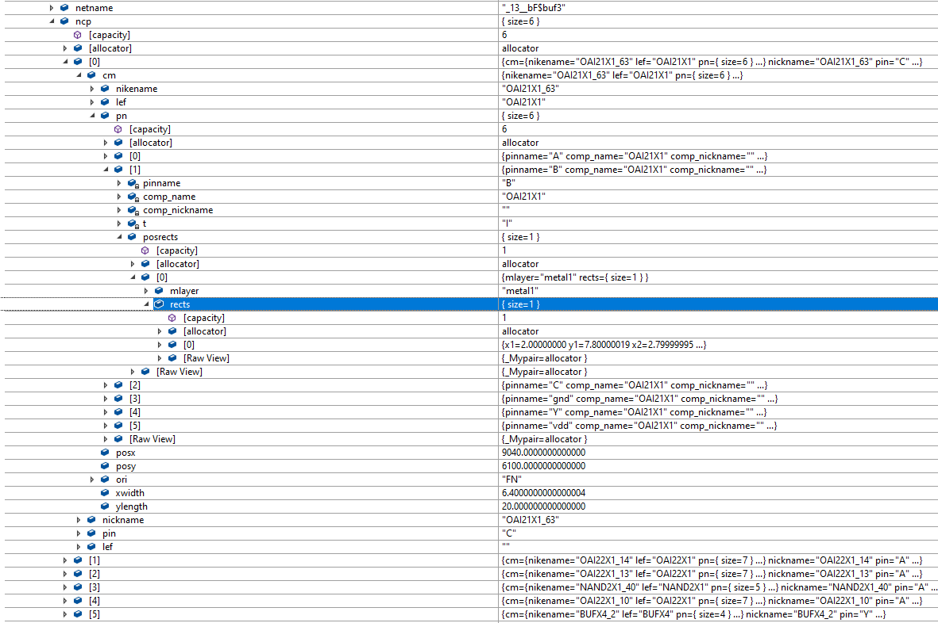
4. Nets:
For each net:
Net name
Net components
Associated pin in the net section
Macro name
All pins for this macro
Pinname
All the rects with their metal layer
Position and orientation of the net component on the grid
Dimensions of the net component (width and height)

Slide 19
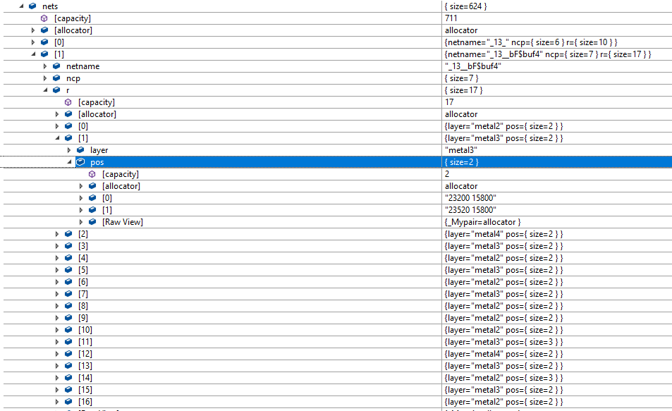
3. Vector of routes (r)
Metal layer of route(wire)
Coordinates of points that the wire connects

Slide 20
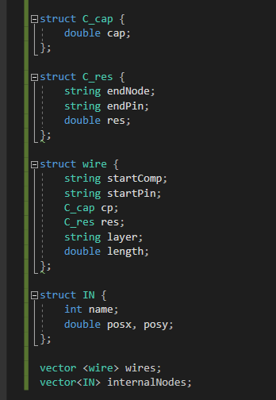
Now, we will explore the data structure that contains the info that generates the SPEF file…..
For ever net there is a vector of struct wires. Each wire contains:
A-A start node (this could be one of the net components with their associated pin or an internal node that is created)
B- C_cap this represents the capacitance of the wire and the start node is the same as the wire ( the endNode is always the ground)
C- C_res this contains the endNode as well because resistance connects between two nodes ad the value of the resistance.
D- Length of the wire
For each net, there is a vector of wires according to the number of routes.

Slide 21

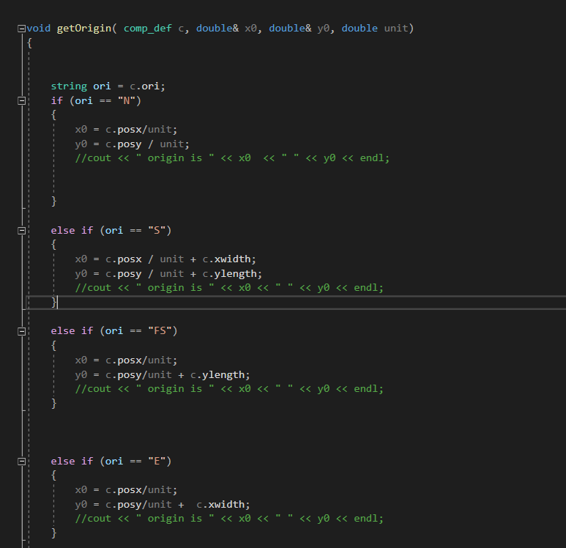
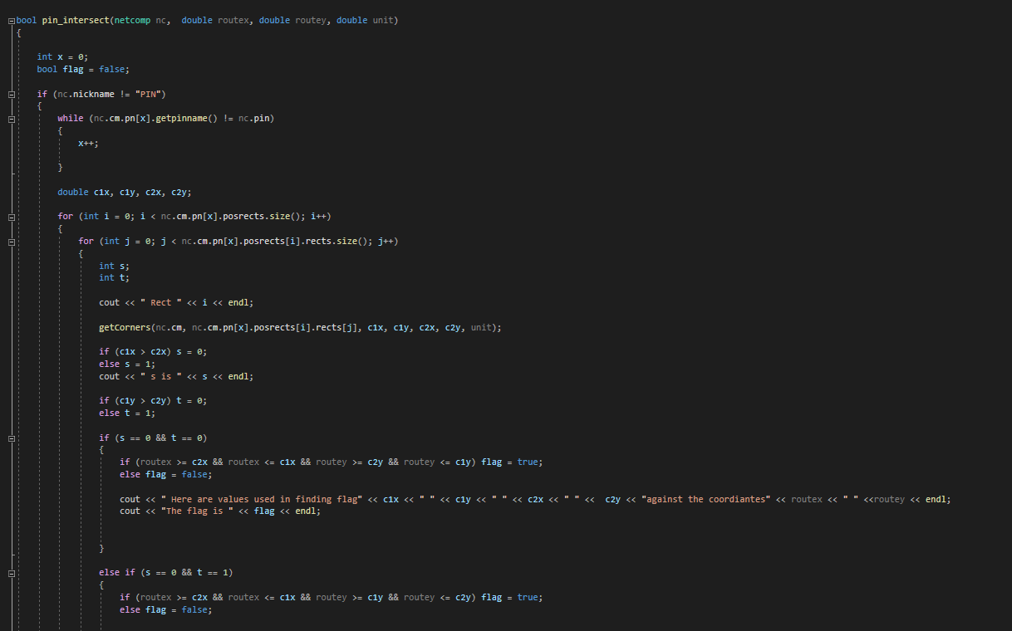
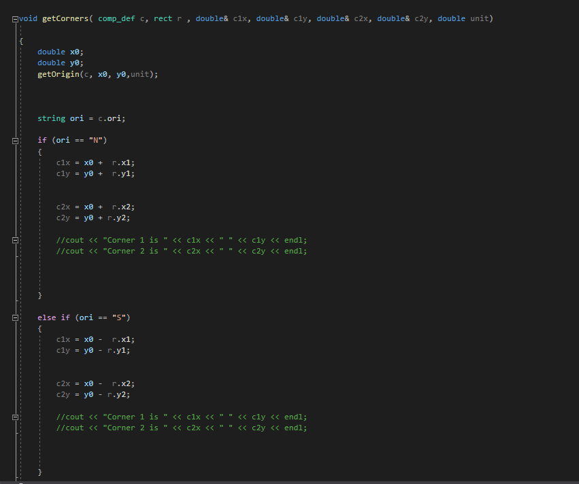
Main Functions
getOrigin gets the new origin of the component on the grid based on the position of the component and orientation in the def file ( there are 8 cases)
getCorners gets the coordinates of the two corners of the rects associated with the pins based on the orientation and the new origin calculated previously
pin_interesect a net component and a coordinate is passed to this function and the intersection is checked according to all the rects associated with the pin associated with the net component

Slide 22
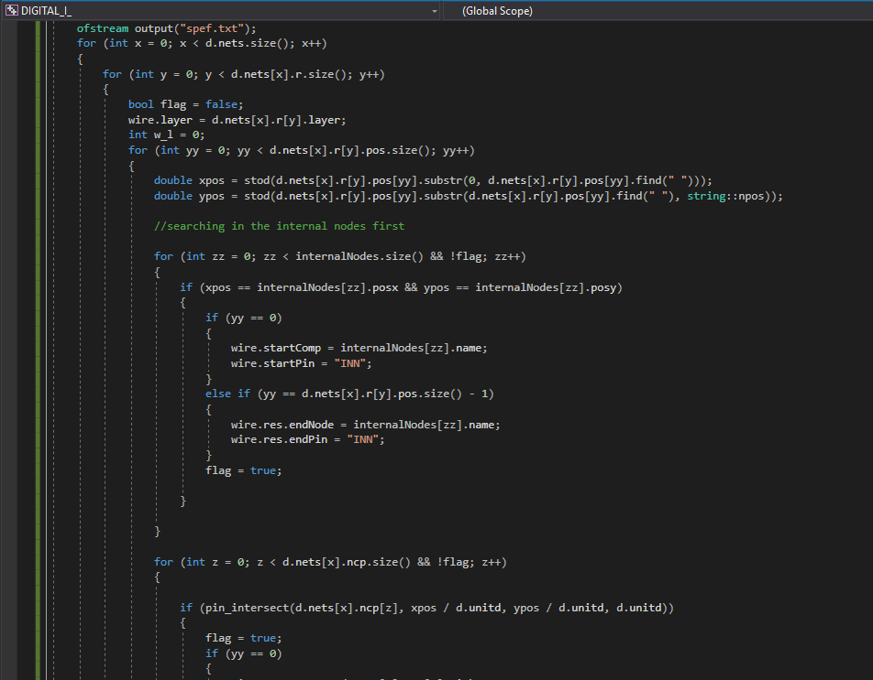
The main itself
Within the main, for every net we go through every route and check for intersections between coordinates and components/internal nodes and determine the start and end node of the wire. The length of the wire is calculated and the resistance and capacitance for each is calculated and stored in the wire. For every net, there is a vector of wires. Then the spef file is generated.

Slide 23
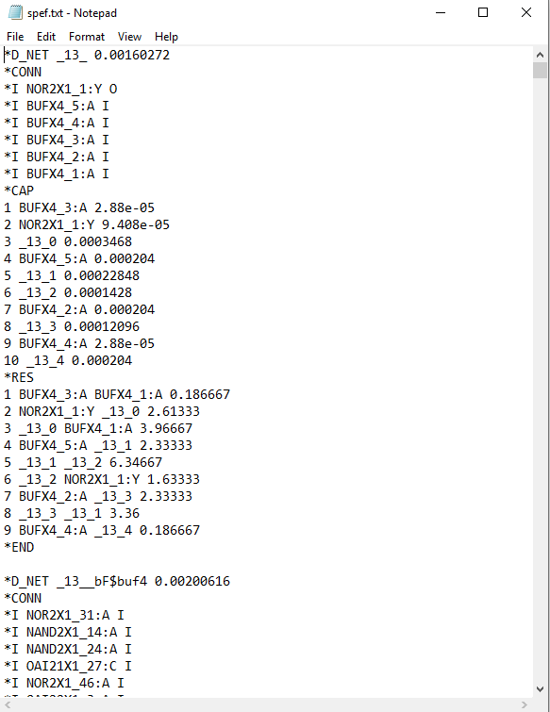
Output
This is the SPEF geenrated using timer.def and osu035.lef

Slide 24
Limitations
1)Even though we outputted SPEF files, we did not test if they are correct as we were having issues with OpenSTA.
2) Since we created our own parsers, we are assuming that tall def files follow the same format as timer.def so any format that is different ( in terms of indentation and categorization) will not be supported.

Slide 25
Questions?

